Slide 1
CHATGPT AND GPT MODEL - COMPREHENSIVE STUDY
Rahul Biswas MSc. Computer Science Semester 3
University of Calcutta

Slide 2
Introduction: 07-02-2025
Overview of GPT and its importance
GPT (Generative Pre-trained Transformer) is an advanced AI model for Natural Language Processing.
Why is ChatGPT revolutionary?
ChatGPT can generate human-like text responses.
Applications in various fields
Used in education, healthcare, business, and content creation.

Slide 3
WHAT IS GPT? 07-02-2025
Generative Pre-trained Transformer (GPT)
Developed by OpenAI
Uses deep learning for Natural Language Processing (NLP)
Based on the Transformer architecture
Continuously improving with larger datasets and more powerful models

Slide 4
THE TRANSFORMER ARCHITECTURE
07-02-2025
self-attention mechanism for understanding context
Multi-head attention to process multiple aspects of text
Feedforward networks for efficient processing
Eliminates need for sequential processing, improving efficiency

Slide 5
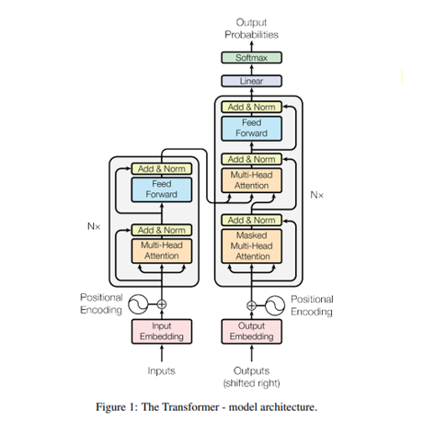
07-02-2025

Slide 6
HOW GPT WORKS? 07-02-2025
Pre-training and fine-tuning
Predicting the next word using probabilities
Uses only the decoder part of the Transformer model
Can generate contextually relevant responses
Improves over time with reinforcement learning

Slide 7
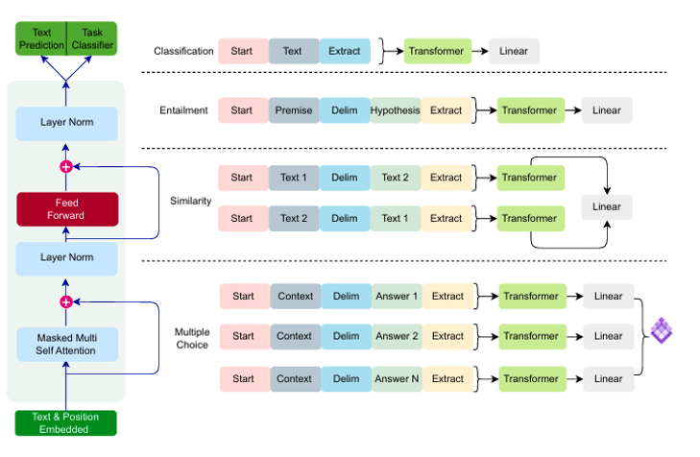
07-02-2025

Slide 8
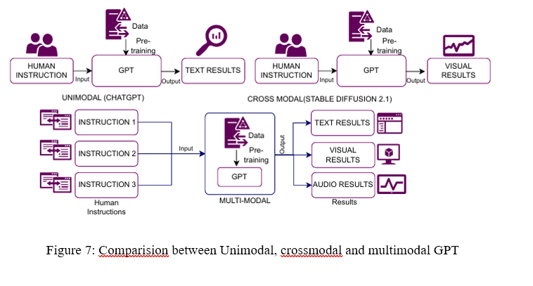
DIFFERENT MODALS
07-02-2025

Slide 9
EVOLUTION ON GPT
07-02-2025
GPT-1 (2018) – 117M parameters
GPT-2 (2019) – 1.5B parameters
GPT-3 (2020) – 175B parameters
GPT-4 (2023) – Multimodal, enhanced reasoning
Future versions may include improved multimodal understanding

Slide 10
IMPACT ON EDUCATION
07-02-2025
AI-powered tutors and learning assistants
Automated grading and feedback
Helps with research and academic writing
Language translation and accessibility for students

Slide 11
IMPACT ON HEALTH CARE
07-02-2025
AI-driven diagnosis and patient support
Summarization of medical records
Mental health chatbots
Drug discovery and personalized medicine

Slide 12
IMPACT ON INDUSTRY
07-02-2025
AI-driven customer support
Content creation and marketing
Fraud detection in finance
Predictive analytics and data-driven decision making

Slide 13
CONCLUSION
07-02-2025
Future implications of ChatGPT
Role of AI in shaping future technologies

Slide 14
THANK YOU!!

